Slide 1
Governance and Compliance

Slide 2
Management Group
Management Groups provide a level of scope above subscriptions.
Enables:
Organizational alignment for your Azure subscriptions through custom hierarchies and grouping
Targeting of policies and spend budgets across subscriptions
Compliance and cost reporting by organization

Slide 3
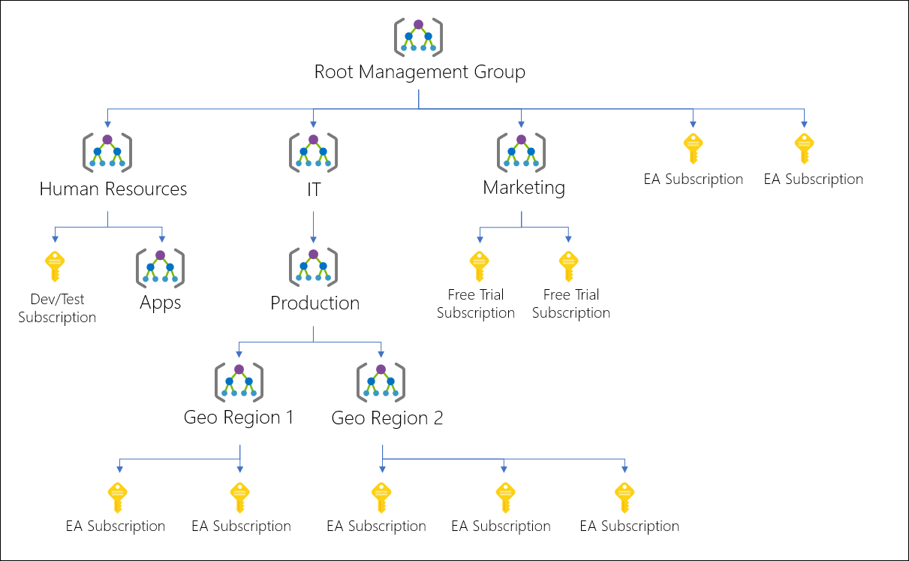

Slide 4
Azure Subscriptions
Logical unit of Azure services that is linked to an Azure Account
Billing for your Azure Services is done on per-subscription basis.
Users, Groups, Service Principles
Azure resources in resource groups
Authentication &
Authorization
Azure Subscription
Azure Active Directory

Slide 5
Getting a Subscription
Enterprise Agreement
Resellers
Partners
Personal
Pay As You Go
Free Trial
Student
Azure Passes
MSDN

Slide 6
Check Resource Limit
Azure provides the ability to see the number of each resource type.

Slide 7
Tags
You can apply tags to Azure resources to logically organize them by categories.
Each tag consist of name value. Ex: Name as Environment and value as Production.

Slide 8
Tag | Description | Mandatory / Optional
Environment | Production, Dev, Stage | Mandatory
Location | East US, Central India | Optional
Application Name | Name of the application | Mandatory
Application Owner | Owner | Mandatory
Cost Center | Cost Center ID | Mandatory
Maintenance Window | Patching Window | Mandatory
CreationDate | Resource created | Optional
Description | Description of Application | Optional
Department | HR, Marketing, IT, AI | Mandatory
Contact | Contact of Team | Mandatory

Slide 9
Cost Management
Cost Management and Billing
Cost Incurred
Cost By Resource
Budgets and Alerts

Slide 10
Pricing Calculator
Provide estimates in all areas of Azure including compute, databases, networking, storage, web.
https://azure.microsoft.com/en-us/pricing/calculator/

Slide 11
Policy

Slide 12
Azure Policy
Create, assign and manage policies
Enforce different rules over resources, so these resources stay compliant with your corporate standard and service level aggrements.

Slide 13
Benefits
Enforcement and Compliance
Apply Policies at scale
Remediation

Slide 14
Implementing Azure Policy
Browse Policy Definition
Create Initiative Definition (Collection of Policies)
Scope the Initiative Definition
View Policy Evaluation Results

Slide 15














Slide 16
Role Based Access Control

Slide 17
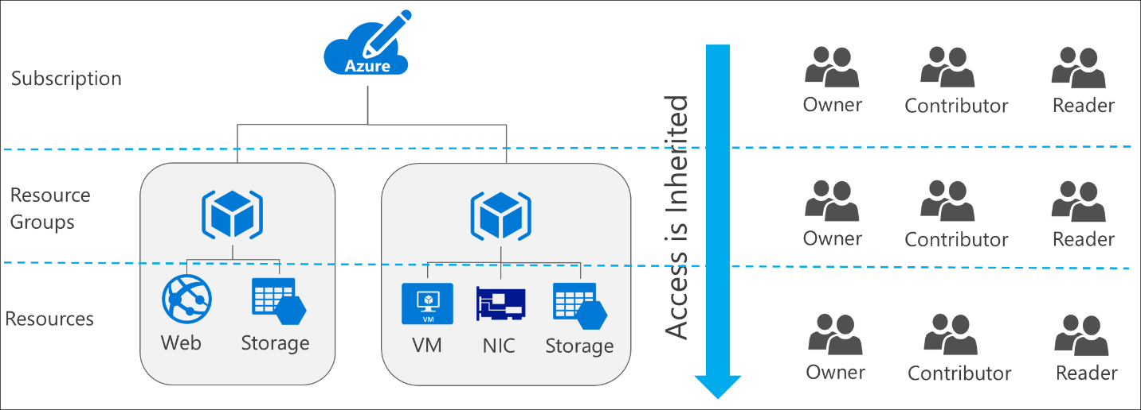



Role Based Access Control
RBAC is capability for you to grant appropriate access to Azure AD Users, groups and services.

Slide 18







Slide 19
RBAC Roles
Owner – Owner can manage everything, including the access
Contributor – Manage everything except access
Reader – Readers can view everything but cannot make changes

Slide 20
Users and Groups

Slide 21
User
Users who require access to resources must have a user account.
Types of Identities:
Cloud Identities – User that only exist in Azure AD Ex: Admin account
Directory-synchronized identities – Users brought into the Azure through a synchronization activity using Azure AD Connect.
Guest User – Users from outside Azure. Ex: abc@gmail.com

Slide 22
Group
Helps organize users to make it easier to manage permissions.
Two Types:
Security Group – Security Enabled and is used to assign the permissions.
Distribution Group – Used mainly by email applications and not security enabled.

Slide 23
















